Slide 1

Mobile Crisis Response (MCR) Integration Protocol
Section 18.J
Memorial EMS – November 2026 Protocol Updates
Tyler Fulks, MD FACEP, FAEMS

Slide 2
Disclosures
The information included here is specific to the Memorial EMS Systems November 2026 Protocols
  Decatur Memorial EMS #0653
  Springfield Memorial EMS #0327
This training is designed to be a review of the Nov. 2026 Memorial EMS Protocols; it is not all encompassing.
As medical professionals, you are expected to know everything in this protocol up to and including your level of care.
The best way to educate yourself to these protocols is to begin by reading the entire document, review this training, and complete any training worksheets.
All EMS providers above the level of Emergency Medical Responder are required to pass a protocol test with a score of at least 80%.

Slide 3

Background
Notes:
The State of Illinois has developed a coordinated behavioral health crisis response system through the Community Emergency Services and Support Act, or CESSA. This initiative allows Mobile Crisis Response Teams to respond to behavioral health emergencies, either as an alternative to or in coordination with traditional EMS.
Our role as EMS clinicians remains unchanged in one important respect: every patient experiencing a behavioral health crisis requires an independent medical assessment. When a patient is medically appropriate for community-based behavioral health care, this protocol provides a pathway for EMS to engage a Mobile Crisis Response Team and help connect that patient with the most appropriate resources.

Slide 4
Goals
Ensure patients receive the most appropriate level of behavioral health care.
Identify patients with underlying medical conditions requiring prompt transport for emergency department evaluation.
Reduce unnecessary emergency department utilization, when appropriate, while maintaining patient safety.
Promote safe collaboration between first responders, EMS, law enforcement, and established Mobile Crisis Response Teams

Slide 5
EMR Care
EMR Care should be focused on identifying immediate life threats, performing an initial behavioral health assessment, maintaining scene safety, and determining whether Mobile Crisis Response activation may be appropriate.
Render initial care in accordance with the Routine Patient Care Protocol.
Oxygen: If respiratory distress is noted, 15 LPM via NRM or if unable to tolerate the mask, 6 LPM via nasal cannula.
  If no obvious respiratory distress is noted, apply a pulse ox. If > 94% and no signs/ symptoms of respiratory distress, no Oxygen is required.
Maintain scene safety.
  Request law enforcement whenever scene safety is compromised or uncertain.
  Do not enter an unsafe scene.

Slide 6
EMR Care (continued)
Perform an initial behavioral health assessment including:
  Mental status
  Ability to communicate
  Decision-making capacity
  Threats toward self or others
  Evidence of hallucinations or psychosis
  Ability to participate in evaluation

Slide 7
EMR Care (continued)
Determine whether an obvious medical illness or traumatic injury may be contributing to the patient's condition.
Patients demonstrating any of the following are NOT appropriate for Mobile Crisis Response evaluation and should be managed according to existing Memorial EMS protocols:
  Acute Medical or Traumatic Complaint
  Abnormal Vital Signs
  Signs/Symptoms of Toxic Ingestion or Overdose
  Acute intoxication impairing assessment
  Active violent behavior
  Any condition requiring immediate EMS intervention or transport

Slide 8
EMR Care (continued)
If the patient appears medically stable and is not an immediate threat to self or others, notify the responding EMS clinician that Mobile Crisis Response may be appropriate.

Slide 9
EMT Care
EMT Care should be directed at conducting a thorough patient assessment, identifying medical conditions requiring EMS intervention, determining whether the patient meets criteria for Mobile Crisis Response evaluation, and facilitating care coordination.
EMT Care includes all components of EMR Care.
Obtain and document (at minimum):
  Blood pressure
  Heart rate
  Respiratory rate
Perform an independent assessment to identify any potential medical or acute traumatic causes of behavioral change.

Slide 10
EMT Care (continued)
Evaluate decision-making capacity.
Assess for suicidal or homicidal ideation.
Determine whether the patient meets criteria for Petitioning an Emotionally Disturbed Patient or Behavioral Emergencies Protocol.

Slide 11
EMT Care (continued)
Patients meeting any of the following shall NOT be referred to Mobile Crisis Response and should be transported by EMS:
  Emergency medical condition
  Lack of decision-making capacity
  Active suicide attempt
  Active suicidal ideation with intent or plan
  Active homicidal ideation
  Need for chemical or physical restraint
  Involuntary mental health evaluation
  Unaccompanied minors
  Provider concern regarding patient safety

Slide 12
EMT Care (continued)
If appropriate, and the patient is agreeable, request activation of the Mobile Crisis Response Team through the established dispatch process.
Remain with the patient until the Mobile Crisis Response Team arrives unless otherwise directed by Medical Control. If Mobile Crisis will be significantly delayed (>20 minutes response to scene) EMS transport should be initiated.

Slide 13
EMT Care (continued)
Provide a verbal report to the Mobile Crisis clinician including:
  Chief complaint
  History
  Mental status examination
  Vital signs
  Any safety concerns
EMS may obtain patient refusal of transport (see, Patient Right of Refusal Policy) after the Mobile Crisis clinician formally accepts responsibility for the patient in accordance with regional procedures.
Contact Medical Control whenever uncertainty exists regarding patient disposition.

Slide 14
A-EMT/EMT-I & Paramedic Care
A-EMT/ EMT-I & Paramedic Care should be directed at continuing or establishing care, conducting a thorough patient assessment, stabilizing the patient’s condition, and preparing for or providing patient transport if indicated.
Care at both levels includes all components of EMT Care.
Obtain peripheral IV access as needed.
  Patients requiring IV access are not appropriate for Mobile Crisis referral.

Slide 15
Critical Thinking Elements
EMS is responsible for ruling out emergency medical conditions, not "medically clearing" psychiatric patients.
The arrival of a Mobile Crisis Response Team alone does not constitute transfer of care. EMS providers shall remain with the patient until a formal handoff has occurred, the receiving clinician has accepted care of the patient, and the patient has executed the required refusal of EMS transport documentation.
Documentation of capacity, medical assessment, and rationale for disposition is essential.

Slide 16
Critical Thinking Elements (continued)
This protocol applies only where an approved CESSA Mobile Crisis Response Team is operational.
Patients who deteriorate or whose condition changes before MCR assumes care should be transported by EMS.
If the patient declines EMS transport but also declines evaluation by the Mobile Crisis Response Team, the patient shall be managed in accordance with the Patient Right of Refusal Policy.
When in doubt, do not hesitate to contact Medical Control.

Slide 17

Mandatory Quality Assessment/Continuous Quality Improvement (QA/CQI)
In communities where an approved Mobile Crisis Response Team has been established, EMS agencies must develop a robust internal QA/CQI that is approved by the Memorial EMS System.
Mandatory 100% review anytime the MCR Team is engaged for community-based behavioral health intervention.
Agency MCR activated case reviews from the previous month should be submitted to the appropriate EMS System by the 15th of the following month.

Slide 18
Behavioral Health Decision Pathway for EMS

Slide 19
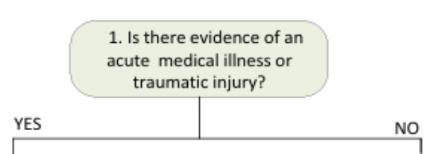
Behavioral Health Decision Pathway for EMS
18.J.4

Slide 20
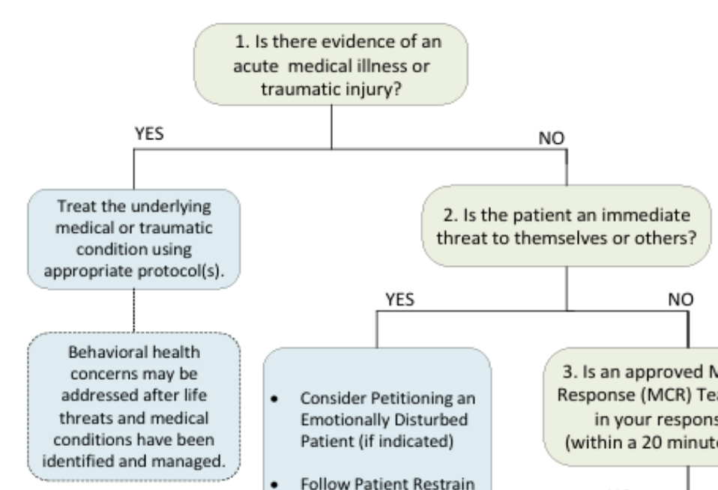
Behavioral Health Decision Pathway for EMS

Slide 21
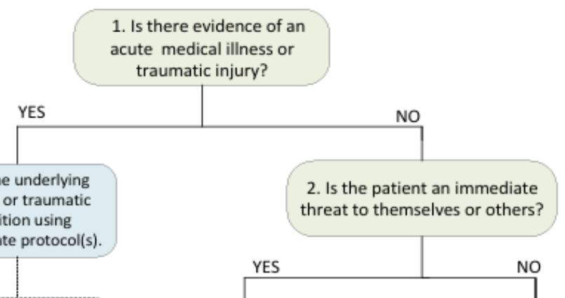
Behavioral Health Decision Pathway for EMS

Slide 22
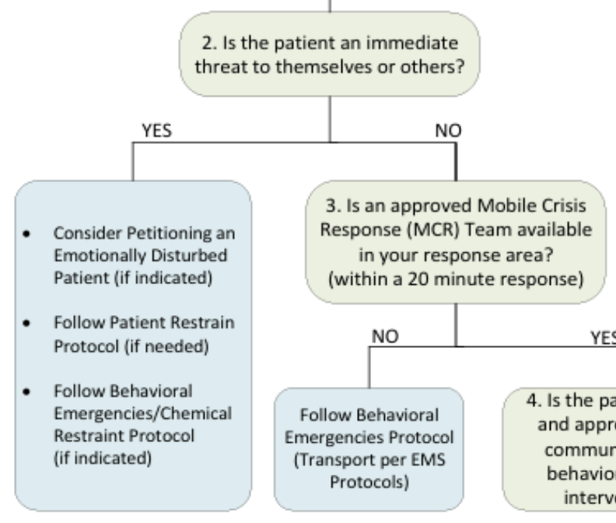
Behavioral Health Decision Pathway for EMS

Slide 23
Behavioral Health Decision Pathway for EMS

Slide 24
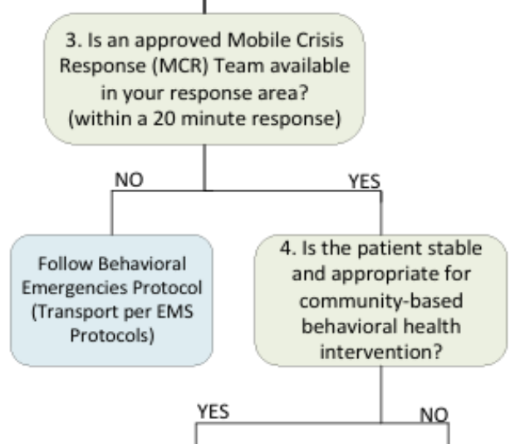
Behavioral Health Decision Pathway for EMS

Slide 25
Behavioral Health Decision Pathway for EMS

Slide 26
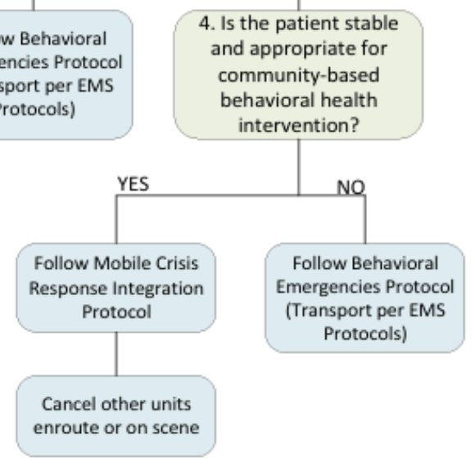
Behavioral Health Decision Pathway for EMS

Slide 27
Behavioral Health Decision Pathway for EMS
Key Reminders:
EMS providers shall perform an independent medical assessment on every behavioral health patient.
Medical and traumatic emergencies take precedence over behavioral health disposition.
When in doubt, transport to the Emergency Department.
Transfer to a Mobile Crisis Response Team requires a formal transfer of care, acceptance by the MCR clinician, and completion of the required EMS refusal documentation prior to EMS leaving the scene.

Slide 28
Thank you.

